Slide 1
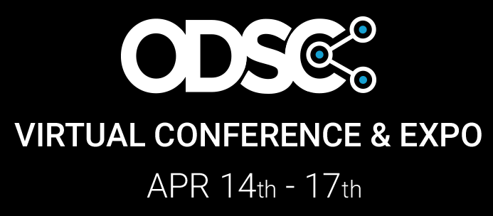
Decision Intelligence & Streaming Predictive Analytics with Spark
Scott Haines
Senior Principal Software Engineer
Voice Insights
http://bit.ly/odsc-2020-streaming-di

Slide 2
1
Introductions
2
Decision Making Process
3
Data Pipelines & Streams
4
Semi-Autonomous and Autonomous Decisioning
5
Hands-On Workshop
http://bit.ly/odsc-2020-streaming-di

Slide 3
Introductions

Slide 4


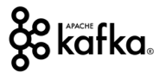

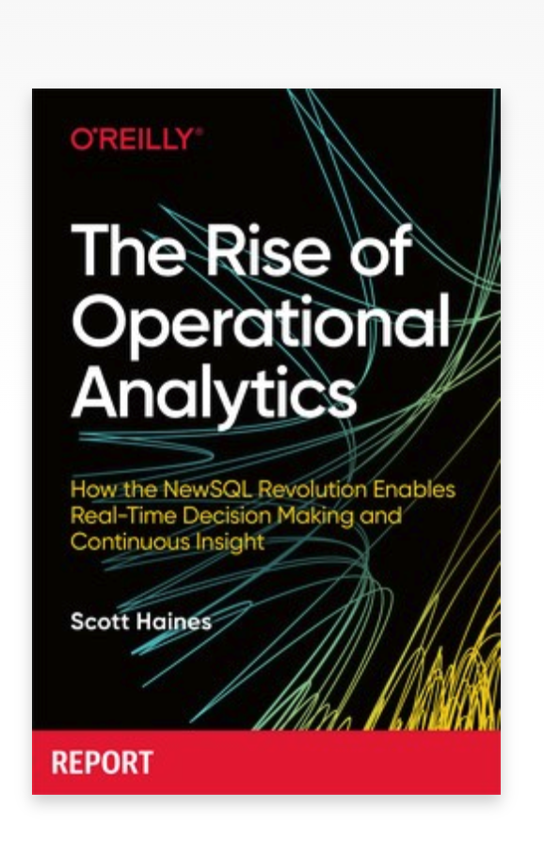
Scott Haines
Senior Principal Engineer
Voice Insights, Twilio
Over Ten Years working on Streaming Systems
Insights, Discovery, Recommendations, Personalization, Fraud, Trends, Ads, and Mobile Campaigns
Recent Release
The Rise of Operational Analytics, O'Reilly

Slide 5
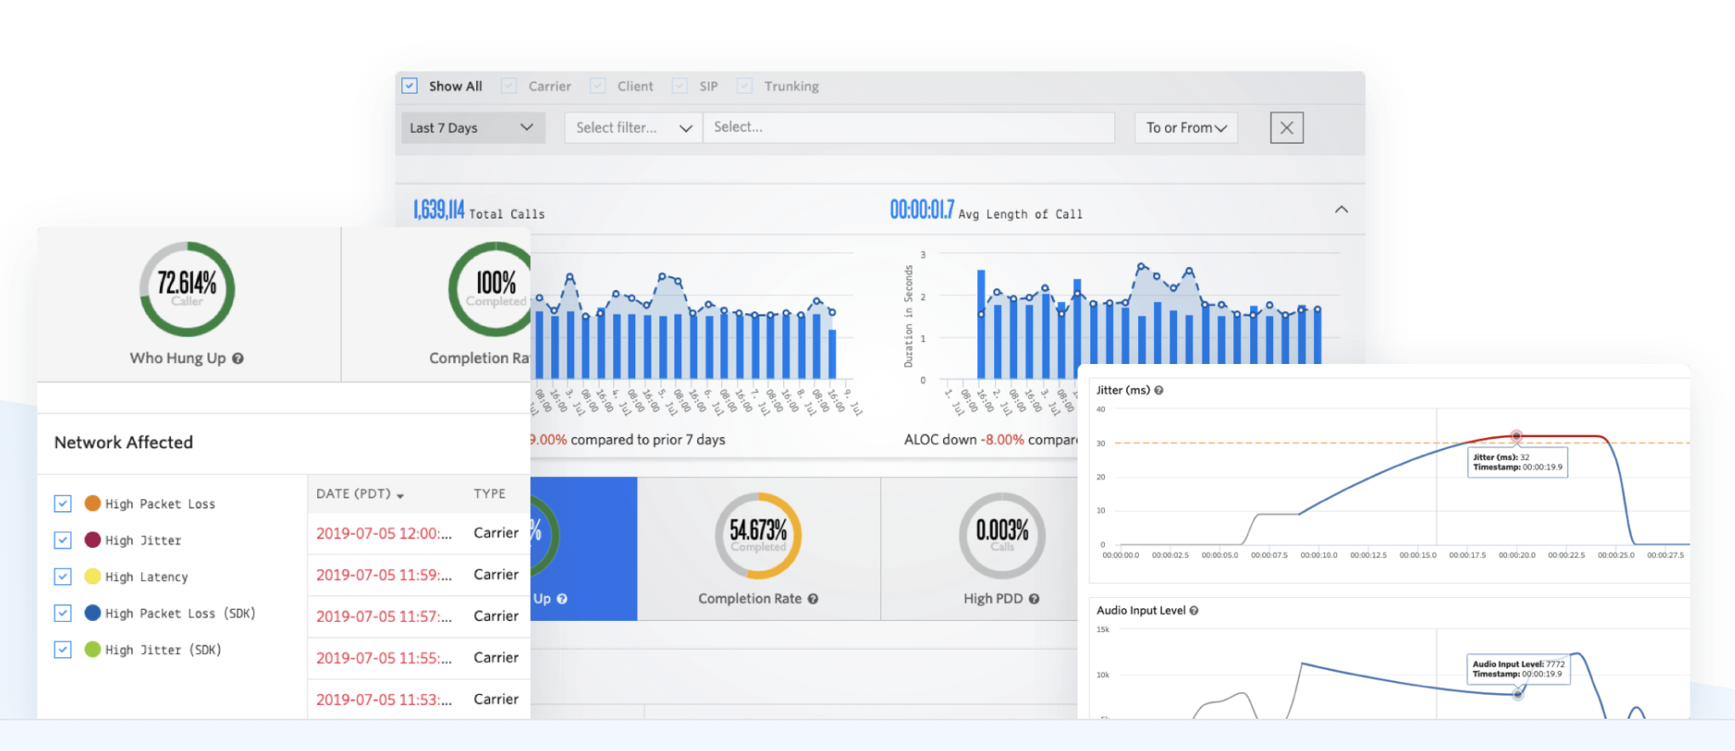
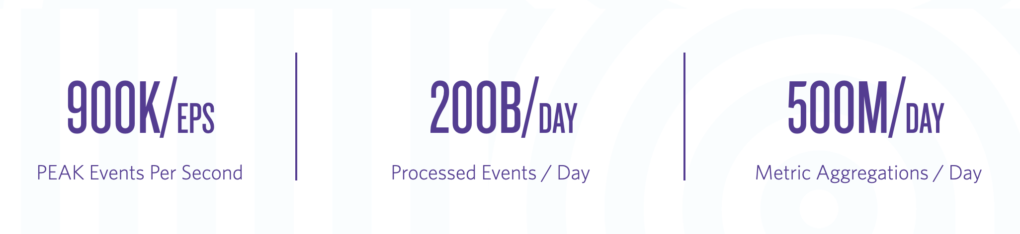
Voice Insights
Interactive Operational Analytics-as-a- Service for Voice.
Ridiculous Scale. Powered by Spark
Learn More

Slide 6
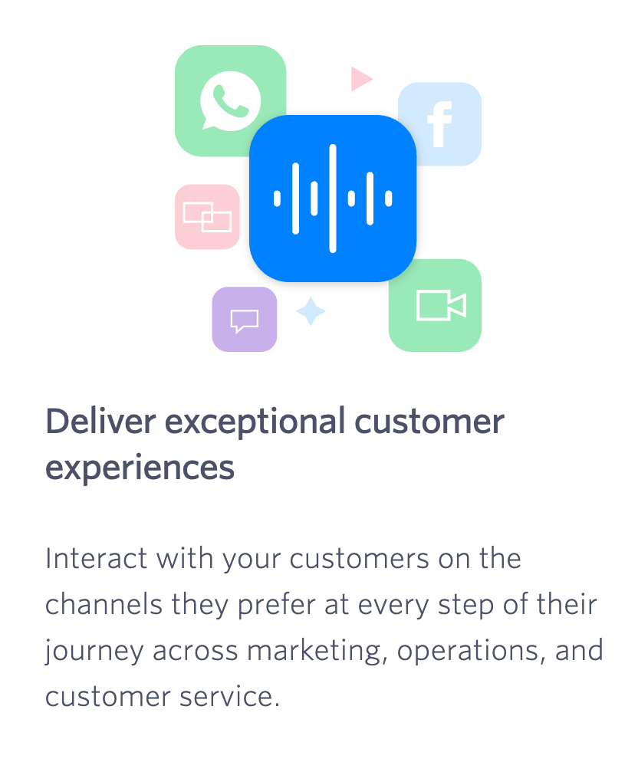
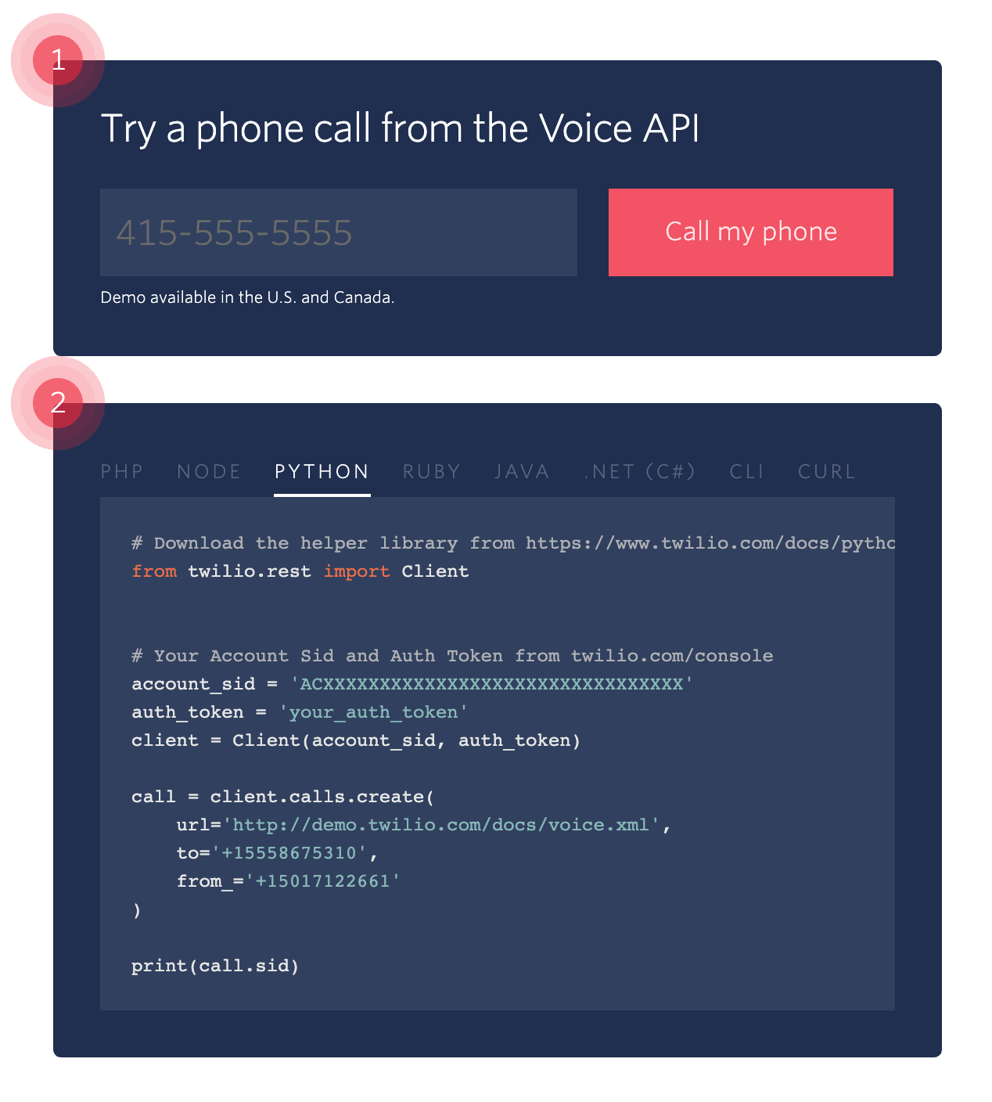

Customer Engagement Cloud

Slide 7
Decision Making Process
How Do We Teach Machines To Think...
A
?
?
B
?
C

Slide 8
If We Can't Define What We Want Them To Know?
Decision Making Process

Slide 9
Decisions are Tough
Decision Indecision
When faced with one or more difficult decisions, What do you do?
Fight or Flight
Instinctive decision making is rooted in nature and based on encoded historic observations.
Do you wake up? Snooze? Turn Left or Right? Avoid that street or Take a known short cut?
Stay the Course or Explore
Do you stick to your what you know ("your gut") or do you explore and find new paths that may yield better reward?

Slide 10
Decision Maker
What is missing that is critical to the Business or Project?
The decision maker is a conduit to the bigger picture. Why are we investing in X or Y?
Machine Learning projects need someone appointed to the role of the Decision Maker.
How do we define a Data Story?
What Questions do we need to ask of our Data? Do we have Data to answer these questions? How do we know it is valid and honest?
How do we define a Decision Domain?
Can we create a general framework for decisioning within a problem domain?
Notes:
Decision Making encapsulates Decision Theory, Cognitive Sciences, Game Theory and so much more.

Slide 11
Decision Maker
Identify a Use Case or Blind Spot
We need to understand why our customers keep cancelling our service.
Build up a Story
Thinks about the expectations of the data for the Business or Project.
By understanding the typical behavior of our customers, we should be able to reduce churn through personalization and other incentives.
Notes:
https://towardsdatascience.com/storytelling-with-data-40708c129f37

Slide 12
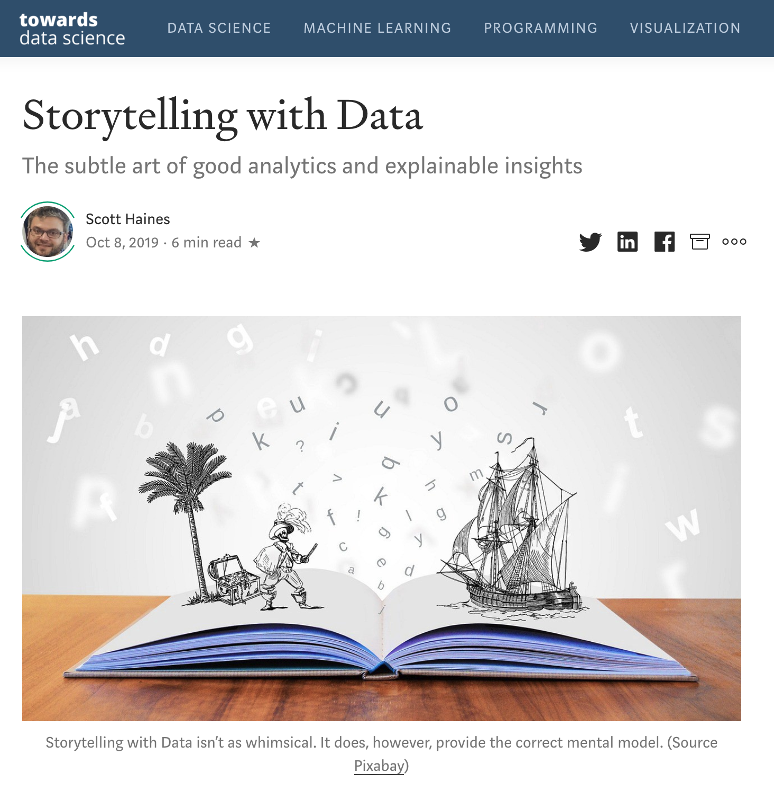
Decision Making
Break into Scenarios
Does the cost of the service influence retention?
Do customers churn at specific times of year?
Do customers in specific regions churn more often than others?
What other dimensions or segments can we identify...
What does your Data Tell You? How can you measure the success of your decisioning?
the article
Notes:
https://towardsdatascience.com/storytelling-with-data-40708c129f37

Slide 13
What Is Your Data Telling You?
Identify Sources of Data
Do we have available data to assist in our decision making?
Can we use the data? eg. Have customers opted-in? GDPR?
Can we trust the data?
What is the lineage of the data?
Is there a Data Steward responsible for quality of the data?
Do we need to start from scratch?
Is there an Open-Source dataset or can we purchase datasets?
Think about the expectations of the data you collect. What surface area does the data cover? Is it raw or pre-processed?
the article
Notes:
https://towardsdatascience.com/storytelling-with-data-40708c129f37

Slide 14
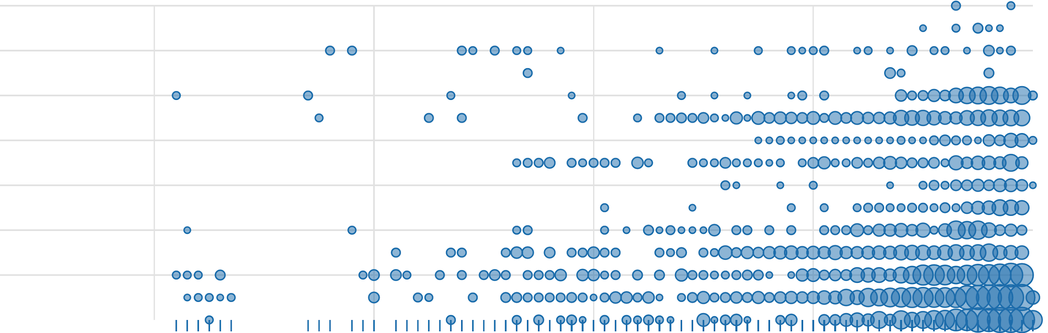
What Is Your Data Telling You?
Explore / Identify / Repeat
For each scenario, within each story, can we identify patterns to backup our assumptions?
Do we need to go back to the drawing board?
Data at this stage can be raw, semi-processed, or fully processed. If this is a new investigation or theory then notebook environments like Zeppelin and Jupyter help teams to share results across the board.
Data Analysts / Data Detectives / Explorers
Active Customers: (millions)
Unique Users Region Per Day (last 6 months)
Notes:
https://towardsdatascience.com/storytelling-with-data-40708c129f37

Slide 15
Feature Engineering
Prepare
Take human readable data and prepare it for Machine Learning models
Scale
Identify and Reshape data distributions to fit normal distributions or normalize the underlying data
Take human readable data and prepare it for Machine Learning models. Remember we are not machines and need more context!
Index / Encode
Take categorical values and class labels and convert these string representations into encoded vectors. StringIndex / OneHot Encoding

Slide 16
Model Selection / Model Tuning
Type of Data
Do you have labels? Supervised otherwise Unsupervised.
Classification or Regression?
Identify and Reshape data distributions to fit normal distributions or normalize the underlying data
Given a clean, prepared dataset, tackle the model selection and tuning problem.
Save for Later
Export your trained model and the preserved Test dataset so you can continue to test enhancements.

Slide 17
Prediction to Decision
Fraud Detection
Historic Fraud patterns can predict what is occurring now, or forecast probability of future fraud. Action is to block fraudulent behavior.
Growth and Re Engagement
Customers who follow known patterns of disengagement can be isolated for outreach based on statistical machine learning model.
Machine Learning Models predict an outcome given an input. Taking an action based on the prediction is a decision.
Cost-Risk Optimization
Farming is beginning to embraced Machine Learning for smart watering. Leveraging live rain forecasts and smart IoT sensors. Take actions to produce better crops.
Notes:
Fraud Detection:
You can create historic models to classify Fraud. These patterns shift like the winds and new threats arise on a daily basis and these "offline" models behave great for specific kinds of fraud and miss new types of fraud. Consider Bayesian Statistical Model or Logistic Regression model with additional weights used to boost or reduce a Fraud score.
Mixing in Go / No-Go rules can save you from shutting down or blocking Key Customers whose behavior changes based on historic Fraud patterns. Add domain rules by joining Customer rules to change the critical thresholds used to protect their interests.

Slide 18
Decision Intelligence holds humans accountable for automated decisioning

Slide 19
Data Pipelines & Streams

Slide 20
Chicken & The Egg
Prepare your Data for Streaming
Streaming systems are always online. 24/7/365. Corrupt data can bring your entire pipeline to a grinding halt.
Data Engineers can help to add strict validations and schema enforcement prior to ingestion into your data streams.
Model the Data
Strictly Enforced Schemas
Streaming systems need something to process. It is typical to model data into the top level domains of Events and Metrics.
Use a Structured Data library like Avro or Protobuf to encode your data into versioned, language agnostic formats.
Notes:
https://towardsdatascience.com/storytelling-with-data-40708c129f37

Slide 21
Enforce Early
Validate at the API or Gateway
Unless you are capturing raw data for experimentation. Enforce and Encode your data before putting it into a Stream.
Searching down corrupt data is hard enough without tracing it all the way to the root.
API / Gateway
Encode at the Service
Stand up an API in front of your Data Pipelines or use a Client Library / SDK to enforce data feeding into your system. This means all data can be uniformly encoded into the current version of your Data Models.
System / User
Kafka Topic
Reject
Notes:
https://towardsdatascience.com/storytelling-with-data-40708c129f37

Slide 22
Semi-Autonomous & Autonomous Decisioning

Slide 23
Human-in-the-mix
Human
Trust is earned. It is okay to have a hybrid system that delegates difficult decisions.
Action Observed
?
Action Taken
Event Data
SparkML
Probably Bad
Slack App
Notes:
https://towardsdatascience.com/storytelling-with-data-40708c129f37

Slide 24
Fully Autonomous
Rinse and Repeat
After trust is earned. Decision making can be delegated to your system.
Risky changes to your models can continue to run through semi-human-supervised mode.
?
Event Data
SparkML
Probably Bad
Action Taken
Notes:
https://towardsdatascience.com/storytelling-with-data-40708c129f37

Slide 25
Workshop
Building Smart Apache Spark Structured Streaming Applications
http://bit.ly/odsc-2020-streaming-di

